Slide 1
42
GEO 42
The Answer Engine
for Enterprise Brands
Generative Engine Optimization (GEO) — GEO 42 makes your brand the definitive answer across every AI engine. Track visibility, optimize citations, and dominate generative search.
See It in Action →
View Case Study
TRUSTED BY LEADING ENTERPRISE BRANDS WORLDWIDE

Slide 2
THE SHIFT
SEO is Linear. GEO is Binary.
In AI search, you are either the cited answer or you are invisible. There is no page two.
SEO
Traditional SEO
GEO
Generative Engine Optimization
Linear distribution model — sites climb from position 10 to 1 through incremental improvements. Multiple sites coexist on page one.
Binary opposition model — AI cites a handful of sources per response. You are either the answer or invisible. Winner-take-all.
#1
#1
#2
#3
#4
#5
Progressive ranking — gradual climb
Binary outcome — cited or invisible
34x
The Search Gap
1000x
AI Chatbot Growth

Slide 3


PROVEN RESULTS
From Invisible to #1
BEFORE
AFTER GEO 42
Which robot vacuum has the best smart navigation?
Which robot vacuum has the best smart navigation?
Based on market data: 1. Roborock 2. Ecovacs 3. iRobot...
The client's robot vacuum is now the top recommendation. Precision laser navigation, 5000Pa suction...
Brand Visibility: 0% — Completely invisible
Share of Voice: #1 — The AI Answer
+220%
#1
5
+15%
Brand Mentions
Share of Voice
AI Platforms
Direct AI Traffic
Deployed across: ChatGPT · Gemini · Perplexity · DeepSeek · Claude · Google AI · Copilot · Meta AI · Grok · Mistral

Slide 4
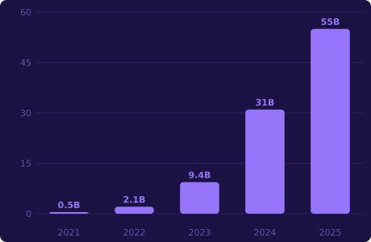
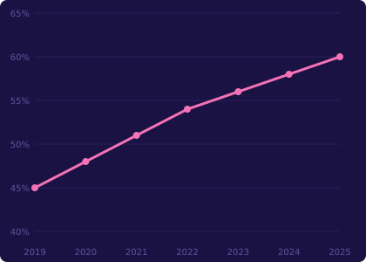
MARKET DATA
AI Search Is Reshaping Discovery
55B+
34x
1000x
60%
Monthly AI Visits
The Search Gap
AI Traffic Growth
Zero-Click Searches
AI Search Traffic Growth (Billions)
Zero-Click Search Rate (%)

Slide 5






THE CHALLENGE
6 Walls Enterprises Face
Discovery Wall
Credibility Wall
Brand Wall
Low indexation and homogeneous pages mean AI crawlers skip you entirely.
Content reads like marketing, not expertise. AI prioritises authoritative sources.
Insufficient brand awareness. Over-reliance on single promotion channels.
Capability Wall
Operations Wall
ROI Wall
Team lacks cross-cultural content expertise for native-quality AI material.
No content strategy, no playbook, no specialised tooling.
Agency outsourcing expensive. In-house slow. Verification cycles eat months.

Slide 6
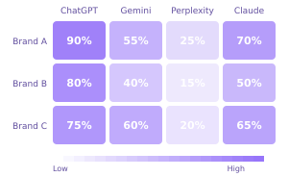
PRODUCT PREVIEW
See the Platform in Action
GEO INTELLIGENT AGENT
BRAND INTELLIGENCE
ID
Prompt
ChatGPT
Google AI
Perplexity
DOUBAO
DEEPSEEK
Q001
Best AI visibility platform
Cited
Cited
Partial
26.25%
31.25%
Q002
GEO optimization tools
Rec: 16.25%
Rec: 21.25%
Cited
Partial
Cited
COMPETITOR HEATMAP
Q003
Monitor AI brand citations
Partial
Cited
Cited
Q004
AI search recommendation
Cited
None
Partial
Q005
Generative engine optimization
Cited
Cited
Cited
Q006
Brand visibility across AI
Partial
Partial
None
Q007
AI content strategy enterprise
Cited
Cited
Partial

Slide 7
GROWTH MODEL
The Visibility Flywheel
More visibility leads to more trust, which drives more transactions, which generates more signals that increase visibility.
Become the Answer
Become the Answer
Position your brand as the source AI engines cite when users ask questions in your category.
42
Win Trust
Build credibility through consistent, high-quality AI-optimized content that earns citations.
FLYWHEEL
Win Trust
Facilitate Transaction
Facilitate Transaction
Convert AI-driven visibility into measurable business outcomes and customer acquisition.

Slide 8




WHAT WE DO
Full-Stack AI Visibility
AI Visibility & Brand
Presence Tracking
Prompt & Demand
Intelligence
AI Response &
Citation Analytics
Monitor mentions, visibility, citations across 10+ AI engines.
Discover what millions ask AI — real-time volume & topics.
Analyse how AI models talk about your brand.
CORE SERVICE
AI Crawler &
Agent Analytics
Traffic &
Attribution Analytics
AI Shopping &
Product Visibility
GEO + SEO Content
Marketing
Monitor AI crawler access, indexing, readability.
Track AI search traffic, conversions, prove ROI.
Boost product visibility in ChatGPT Shopping.
AI-optimised content across all engines.

Slide 9
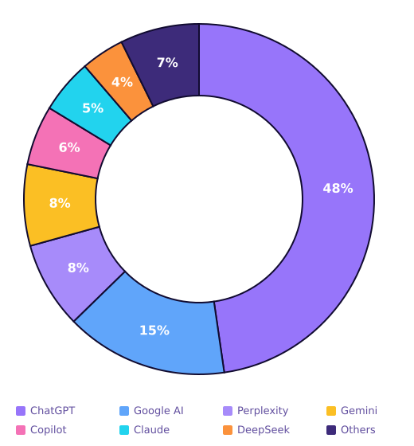
PLATFORM COVERAGE
Every AI Engine. One Dashboard.
#1 AI Search
#1 Search Engine
ChatGPT
Google AI
47.7B visits/mo
AI Overview reach
Fastest Growing
Google Ecosystem
Perplexity
Gemini
500M+ queries/mo
Deep integration
Premium Users
Enterprise AI
Claude
Copilot
Enterprise focus
Microsoft ecosystem
China AI Leader
ByteDance AI
DeepSeek
Doubao
Global expansion
Asia-Pacific reach

Slide 10

STRATEGY
Three-Phase GEO Framework
Phase 1
Phase 2
Phase 3
Expand Sources
Build Reputation
Gain Recommendations
Structured data & schema
Expert endorsements
AI influence strategies
Multi-platform distribution
Consistent brand narrative
Answer-position content
Citation-safe architecture
Industry white papers
Competitive displacement
Entity clarity
Review & social proof
Continuous monitoring

Slide 11

INDUSTRIES
Built for Your Vertical
Software & AI
Advanced Manufacturing
E-Commerce & Consumer
Professional Services
Maximize brand visibility in AI search and answer engines.
Build global AI content marketing systems.
Boost visibility in ChatGPT Shopping & AI discovery.
Become the authoritative answer in AI search.

Slide 12
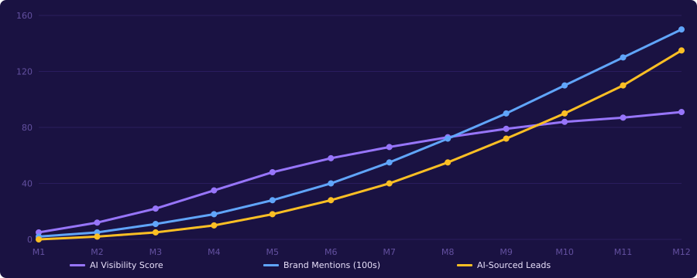
ROI MODEL
Projected Impact Over 12 Months
91%
15,000+
135+
5-8x
Visibility Score
Brand Mentions/Mo
AI-Sourced Leads/Mo
Projected ROI

Slide 13
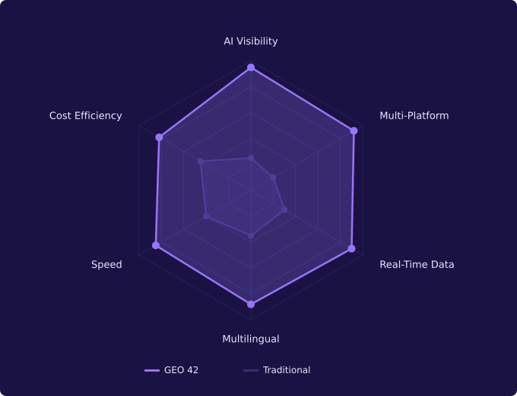
COMPETITIVE ADVANTAGE
GEO 42 vs Traditional Agencies
Why GEO 42 Wins
7 AI agents vs manual labour
Scale content 10x without headcount.
10+ platforms vs Google-only
ChatGPT, Gemini, Perplexity, DeepSeek+
Real-time dashboards
Instant AI performance visibility.
Binary outcome expertise
Winner-take-all dynamics mastery.
Multilingual at scale
Native content across languages.

Slide 14
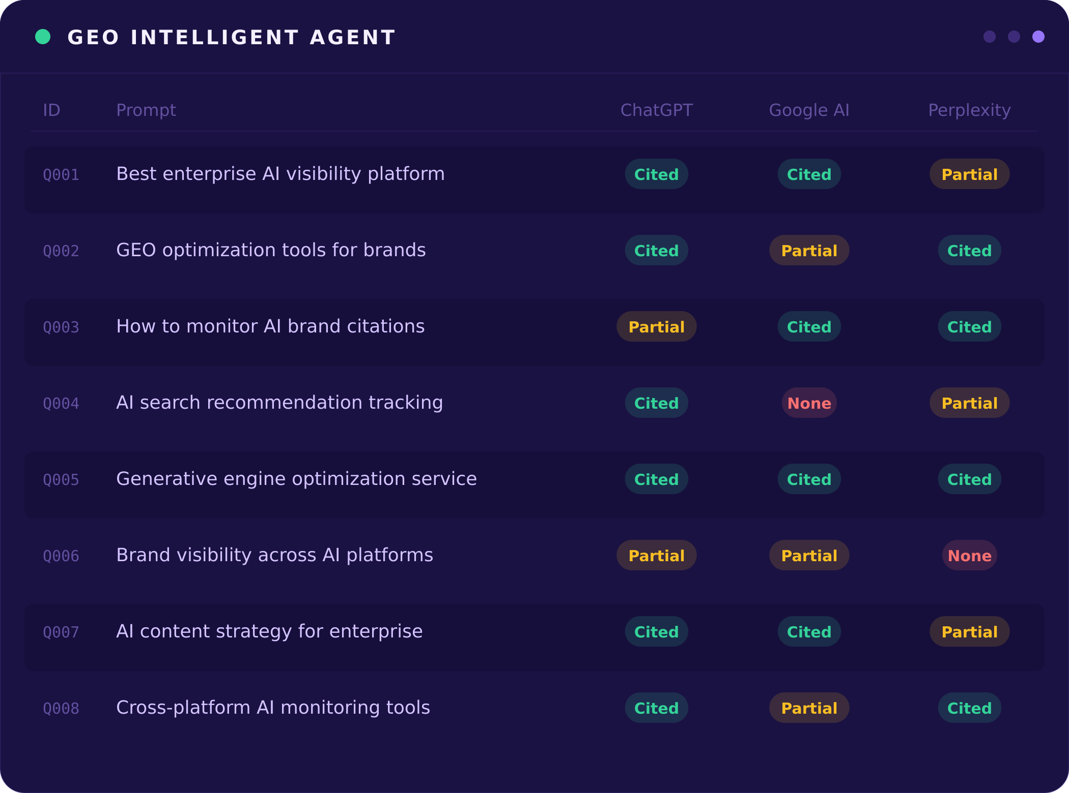
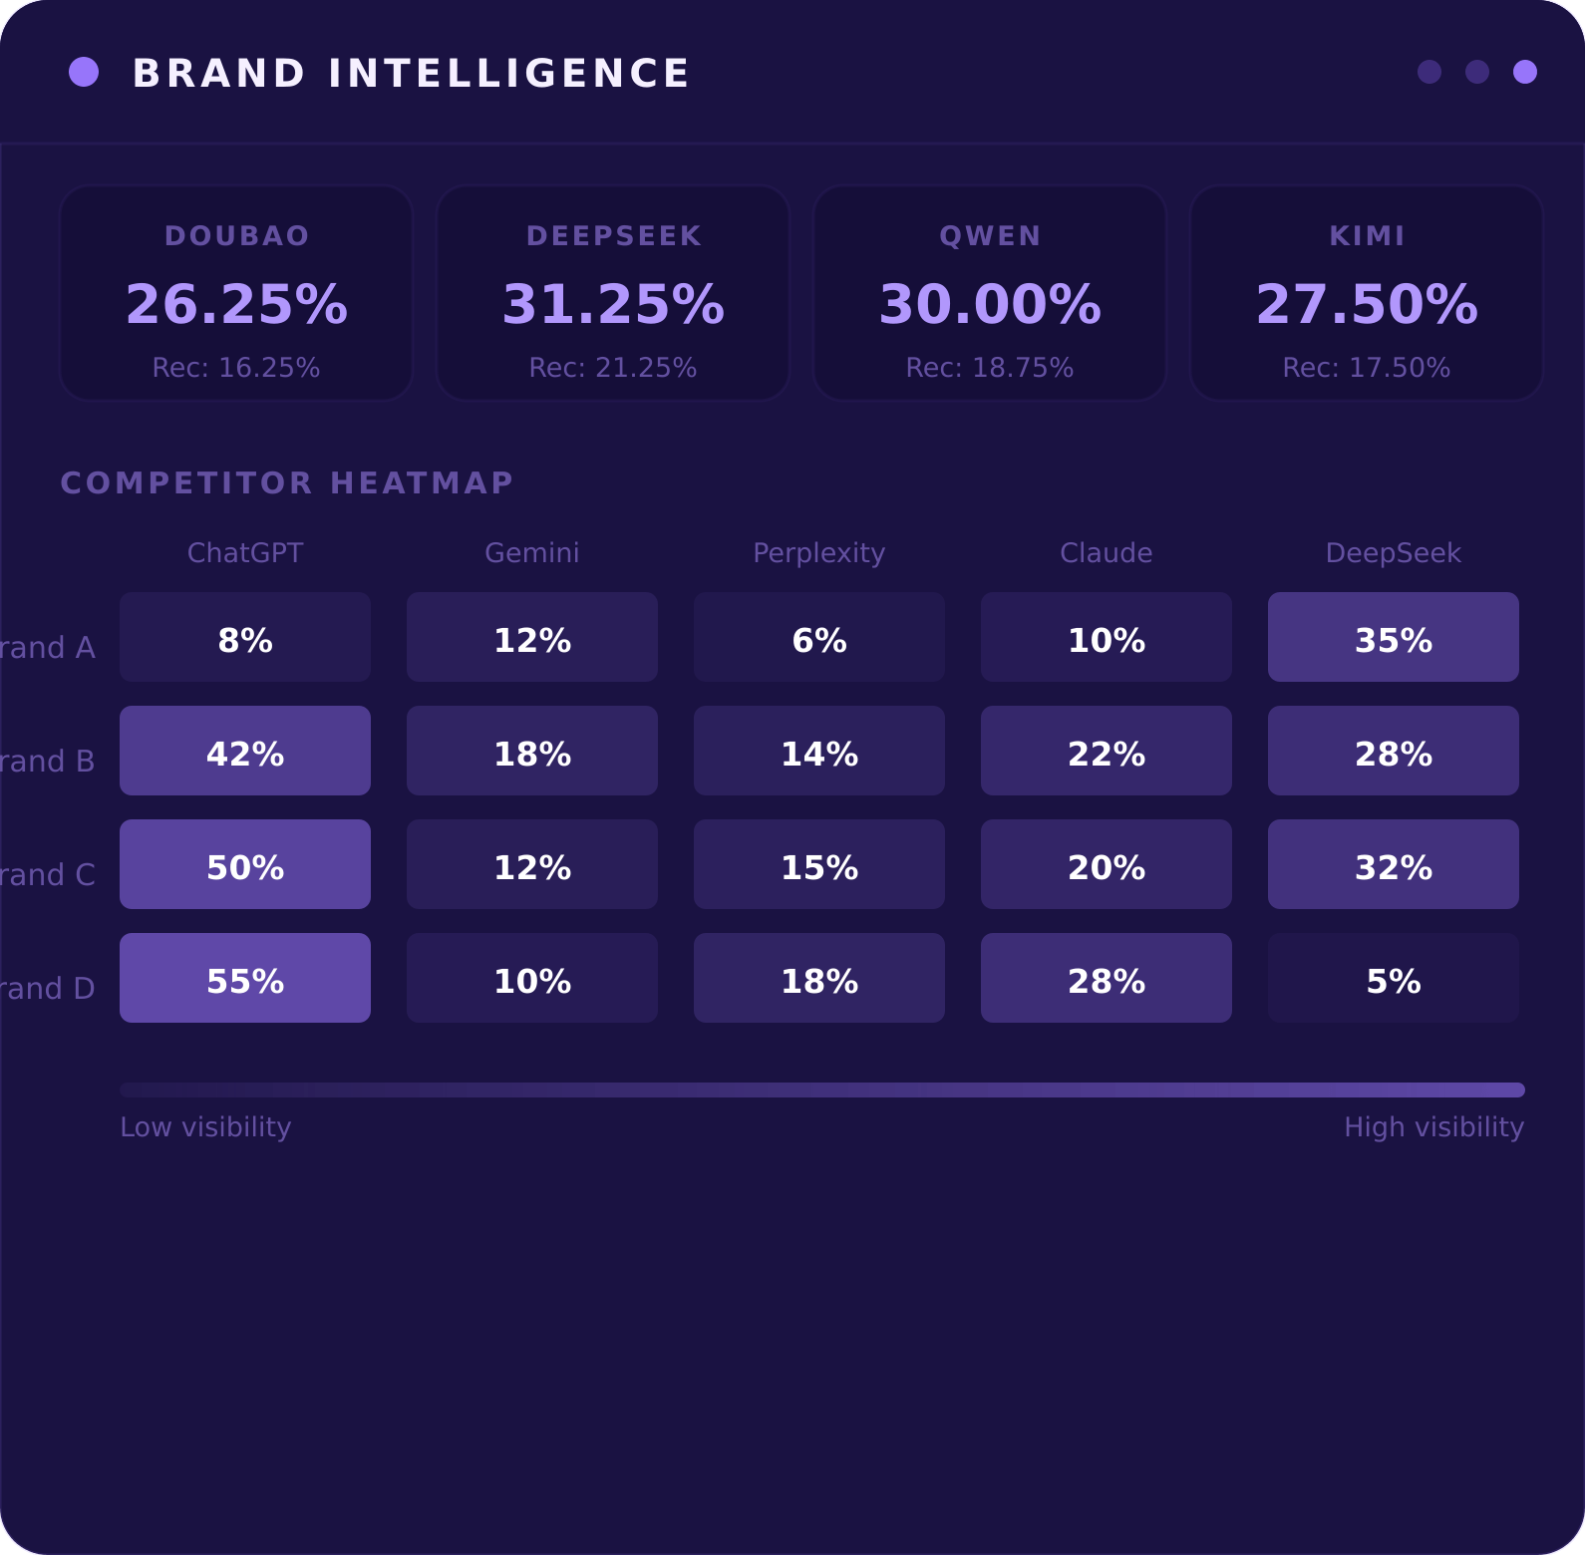
PRODUCT PREVIEW
Intelligence Dashboard

Slide 15
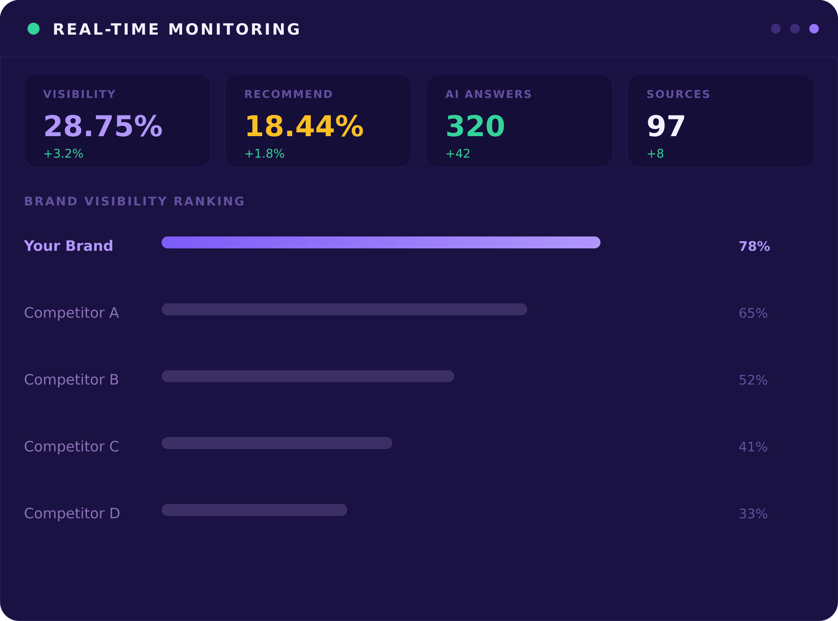
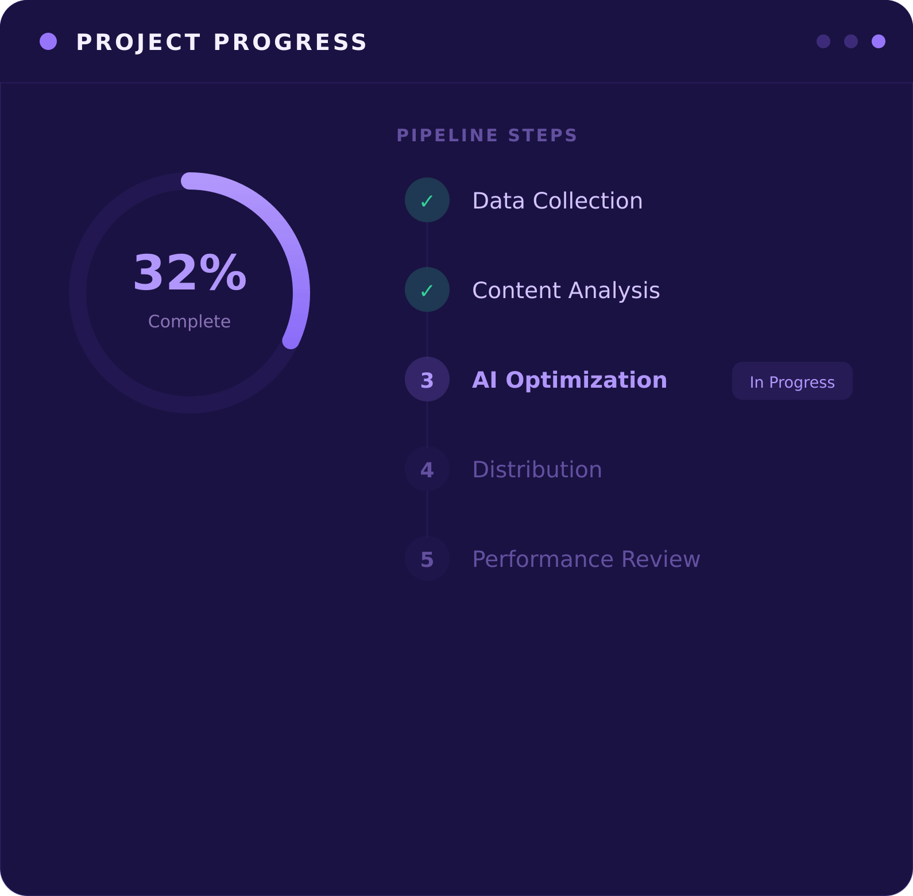
PRODUCT PREVIEW
Real-Time Monitoring & Progress

Slide 16
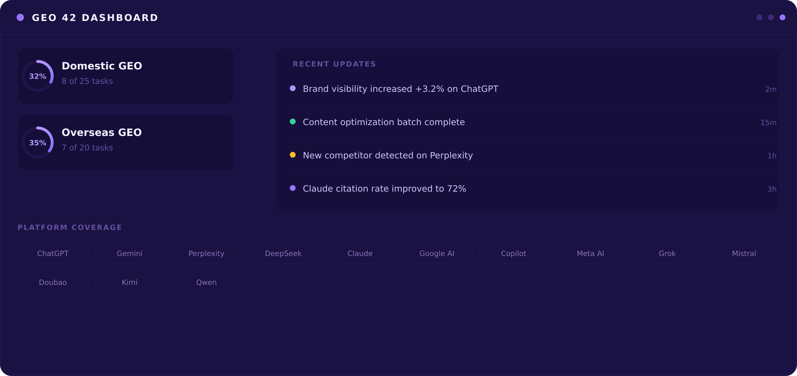
PRODUCT PREVIEW
GEO 42 Dashboard

Slide 17
PRE-ENGAGEMENT AUDIT
SEO → AEO → GEO: The Full Diagnosis
Before every engagement, GEO 42 conducts a comprehensive audit across all three layers to identify gaps and build a tailored strategy.
SEO Audit
AEO Audit
GEO Audit
Foundation Layer
Answer Engine Layer
Generative Engine Layer
Traditional search optimisation — the baseline for AI discoverability.
How well your content feeds featured snippets, knowledge panels, and voice search.
Your brand's visibility, citation rate, and authority across AI search platforms.
Technical health & crawlability
Featured snippet capture rate
AI citation rate across engines
Content quality & E-E-A-T signals
FAQ & PAA optimisation
Brand mention frequency
→
→
Schema & structured data
Knowledge Graph presence
Competitor share of voice
Backlink authority profile
Voice search readiness
Prompt-answer alignment
Page speed & Core Web Vitals
Conversational query mapping
Source authority signals
Keyword positioning & gaps
Direct answer formatting
Cross-platform consistency

Slide 18
SAMPLE AUDIT REPORT
Keeta.com — SEO & AEO Diagnosis
Layer-1 blockchain · $20M raised · Eric Schmidt-backed · 10M TPS · Cross-chain payments
SEO Score
AEO Score
GEO Score
68/100
Average
31/100
Weak
18/100
Critical
Docs site well-structured but main site thin on content. Limited blog/educational pages. Schema partially implemented.
Zero featured snippets. No FAQ schema. Technical docs not formatted for answer extraction. No PAA presence.
Competitors (Solana, Ripple) dominate AI responses for cross-chain & L1 queries. Keeta rarely cited.
AI CITATION CHECK
◐
ChatGPT
○
Google AI
◐
Perplexity
○
Gemini
●
Claude
Mentioned only for TPS benchmarks
Not cited in L1 blockchain queries
Cited via PR articles only
Absent from cross-chain queries
Best citation — via Google Cloud blog
KEY FINDINGS & RECOMMENDATIONS
Layer
Issue Found
Recommendation
Priority
SEO
Thin content on keeta.com — most info in docs.keeta.com
Build educational hub: 'What is L1', 'Cross-chain explained'
High
SEO
No blog or news section on main domain
Create /blog with weekly thought leadership & ecosystem updates
High
AEO
Zero featured snippets for 'fastest blockchain' queries
Add comparison tables, FAQ schema, direct-answer formatting
High
GEO
Solana/Ripple cited 4x more in AI for cross-chain queries
Create AI-optimized authority content for prompt clusters
Critical
GEO
Google Cloud partnership not surfacing in AI responses
Amplify Spanner case study across citation-worthy channels
Critical

Slide 19

42
Ready to Become
the AI Answer?
See how GEO 42 can transform your brand from invisible
to indispensable across every AI platform.
See It in Action
Contact Us
hello@geo42.ai | geo42.ai

